Slide 1
Sequence Models with Apache MXNet
Sandeep Krishnamurthy
Amazon AI

Slide 2
Agenda
Motivation – Sequence Models
Natural Language Processing – Basics
Recurrent Neural Networks (RNN)
Long Short Term Memory (LSTM)
Lab – Sentiment Analysis

Slide 3
Motivation – Sequence Models

Slide 4
Applications with Sequence Data
“Alexa. Tell me a joke!”
Speech recognition
Machine translation
Voulez-vous chanter avec moi?
Do you want to sing with me?
Sentiment classification
“There is nothing to like in this movie.”
Notes:
Context v/s Patterns
Why we need a Sequence Model?
Next an example Image than text.

Slide 5
Image v/s Sequence Data
Context
Pattern Recognition
Credits - https://tinyurl.com/yc8twa8o; https://tinyurl.com/y725b7bg

Slide 6
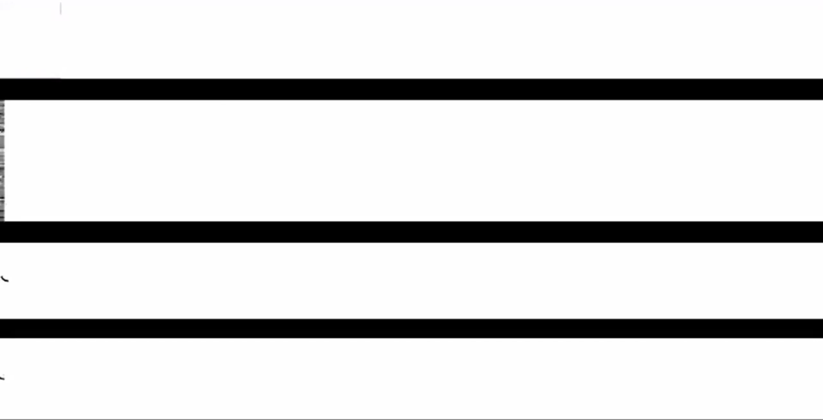
Handwriting Recognition by Alex Graves
Credits - https://tinyurl.com/y8bburt7
Notes:
Credits – Link to Cyrus Github

Slide 7
Natural Language Processing - Basics

Slide 8
Words - One Hot Vectors
Vocabulary or Dictionary with list of all the words
One hot encoded vector for each word
Credits - https://tinyurl.com/ya4bu5wv

Slide 9
Words – One Hot Vectors - Problems
Orange => Fruit
Apple => _____?
10,000 word Vocabulary
Problems
Relations are not captured
No Generalization
Credits - https://tinyurl.com/ydf72mq6
Notes:
Credits - https://www.coursera.org/learn/nlp-sequence-models/
Apple at 456th position in one hot vector
Orange at 6257th position
Add animations.
May be different explanation or simple example.
Similarity
Synonym Example

Slide 10
Words - Embeddings
4 Dimension (Features) Embedding
Each word is a vector of these 4 features
Orange => Fruit
Apple => Fruit
Credits - https://tinyurl.com/ydf72mq6

Slide 11
Words – Embeddings (contd…)
Credits - https://tinyurl.com/yagpo8og

Slide 12
Embeddings – In Practice
Pre-Trained Embeddings: Billions of words, different techniques.
Example: GloVe, Word2Vec, FastText
GloVe: Ratios of word-word co-occurrence probabilities have some information and meaning
Credits - https://nlp.stanford.edu/projects/glove/

Slide 13
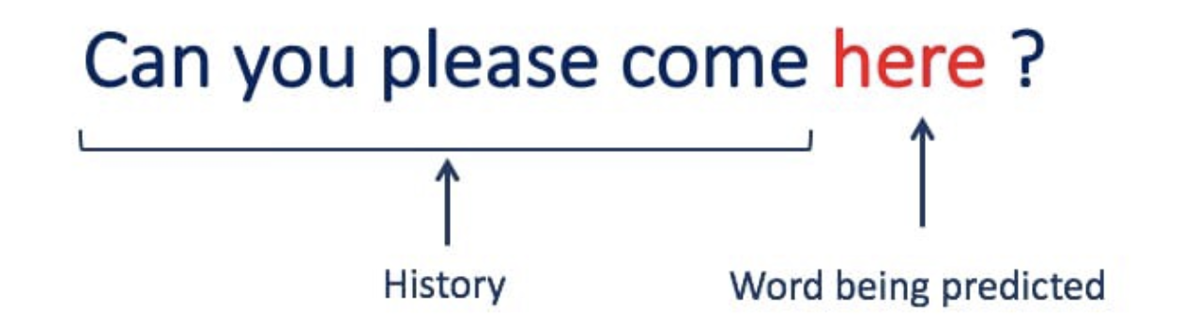
Language Model
Estimate the probability of the sequence of words(statement)
Credits - https://tinyurl.com/zytlcy5

Slide 14
Notations

Slide 15
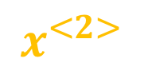
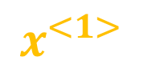
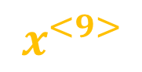
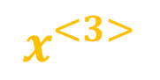
Representing a sentence
x:
Harry Potter and Hermione Granger invented a new spell.
$$x^{<1>}$$
$$x^{<2>}$$
$$x^{<3>}$$
…
$$x^{<9>}$$
$x^{<1>}$.. $x^{<9>}$ => Embedding vectors for each word in the sentence

Slide 16
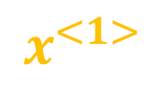
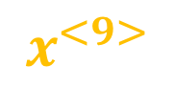

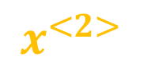
Sequence Model - Problem Formulation
Given a Sequence X:
X:
Predict Y
Y -> Discrete (Ex: Sentiment Classification)
Y -> Sequence (Ex: Language Translation)
$$x^{<1>}$$
$$x^{<2>}$$
$$x^{<3>}$$
…
$$x^{<9>}$$

Slide 17
Recurrent Neural Networks (RNN)

Slide 18
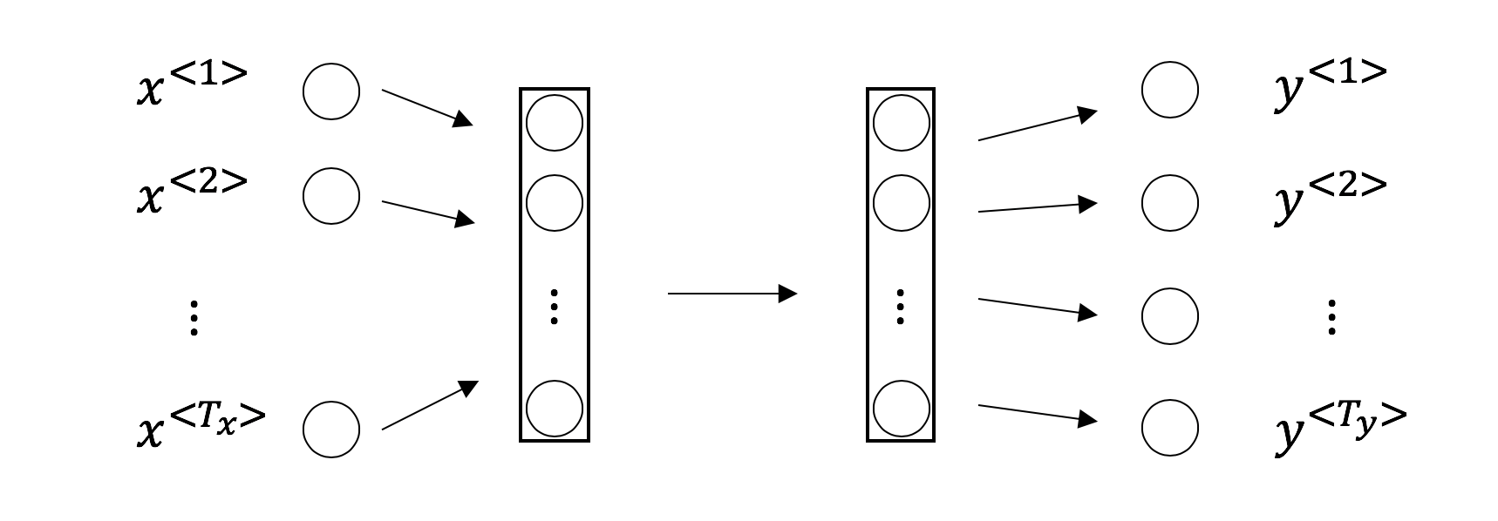
Sequence Data – MLP - Problems
Variable Length Inputs
Memory / Context
Too complex, too many parameters
Credits - https://tinyurl.com/ydf72mq6
Notes:
Problems:
Variable length inputs: One sentence can have 10 words, others 3 words
Sharing of learnings: Harry appearing in first location gives a hint it is a named entity. However, if Harry appears again this already known info is not used
Too complex, too many parameters: Remember each x<t> is a one hot vector of size vocabulary usually in the range of 30-40k, and it can too quickly explode with the parameter size

Slide 19
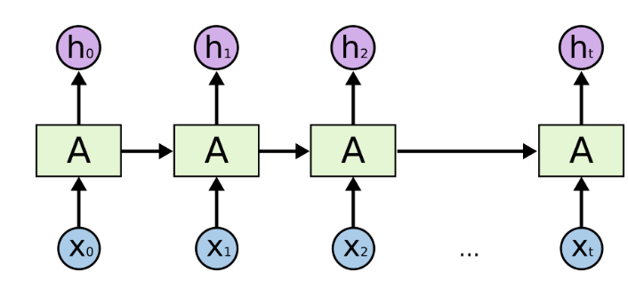
RNN
Terminologies
Time Step
RNN Cell
Unrolled
Variable Length Inputs
Memory / Context
Less Parameters
Credits - https://tinyurl.com/q6dcybc/
Notes:
Time Step – One word / character
RNN Cell - One unit in time step with 1 hidden layer

Slide 20
RNN – Long Range Dependencies
Cat ate stomach full, ….., was sleeping on the bed.
Cats ate stomach full, ….., were sleeping on the bed.
Problem: Assuming the sequence is long, it will be hard to “memorize” or “capture” the long-range singular/plural dependencies
Solution: Have some memory by passing on some extra information?

Slide 21
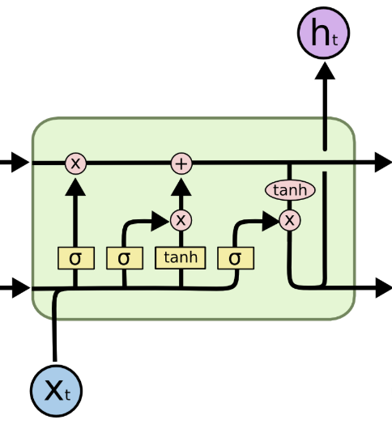
Long Short Term Memory (LSTM)
3 Inputs: Hidden State, Memory(Cell) State, x<t>
2 Outputs: Memory, New hidden state
Credits - https://tinyurl.com/q6dcybc/
Notes:
3 Inputs: Hidden State, Memory(Cell) State, x<t>
Forget Gate: What to forget from previous hidden and current input
Input Gate: Calculate current cell state from previous hidden and current input
Output Gate: Calculate new hidden state from current input, previous hidden
2 Outputs: New Memory(Cell) State, New hidden state

Slide 22
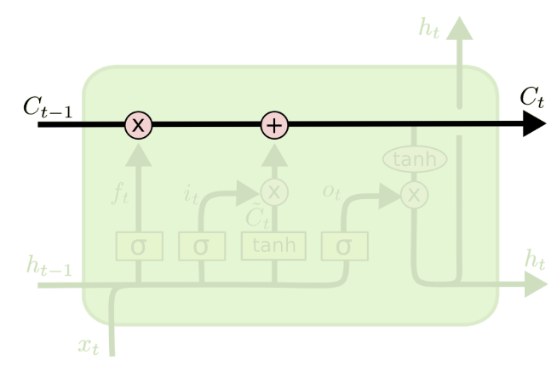
Long Short Term Memory (LSTM)
3 Inputs: Hidden State, Memory(Cell) State, x<t>
Information Highway
Credits - https://tinyurl.com/q6dcybc/
Notes:
3 Inputs: Hidden State, Memory(Cell) State, x<t>
Forget Gate: What to forget from previous hidden and current input
Input Gate: Calculate current cell state from previous hidden and current input
Output Gate: Calculate new hidden state from current input, previous hidden
2 Outputs: New Memory(Cell) State, New hidden state

Slide 23
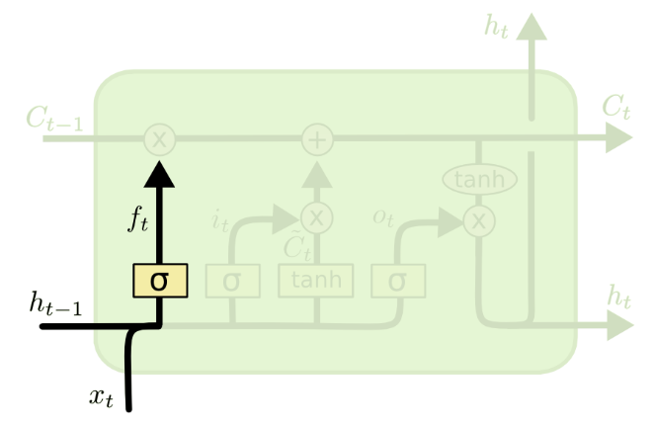
Long Short Term Memory (LSTM)
3 Inputs: Hidden State, Memory(Cell) State, x<t>
Information Highway
Forget Gate
Credits - https://tinyurl.com/q6dcybc/
Notes:
3 Inputs: Hidden State, Memory(Cell) State, x<t>
Forget Gate: What to forget from previous hidden and current input
Input Gate: Calculate current cell state from previous hidden and current input
Output Gate: Calculate new hidden state from current input, previous hidden
2 Outputs: New Memory(Cell) State, New hidden state

Slide 24
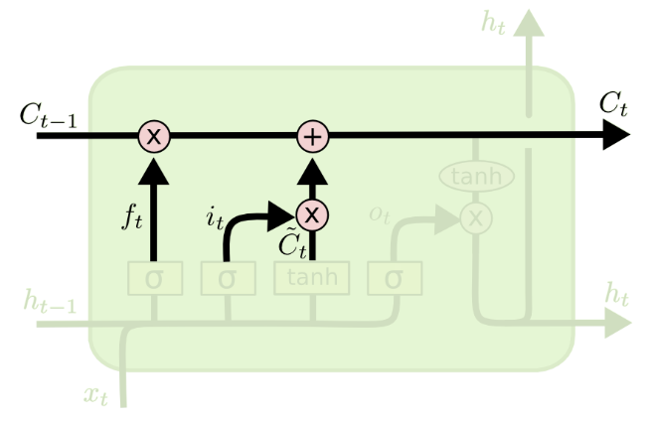
Long Short Term Memory (LSTM)
3 Inputs: Hidden State, Memory(Cell) State, x<t>
Information Highway
Forget Gate
Input Gate – Candidate output
Credits - https://tinyurl.com/q6dcybc/
Notes:
3 Inputs: Hidden State, Memory(Cell) State, x<t>
Forget Gate: What to forget from previous hidden and current input
Input Gate: Calculate current cell state from previous hidden and current input
Output Gate: Calculate new hidden state from current input, previous hidden
2 Outputs: New Memory(Cell) State, New hidden state

Slide 25
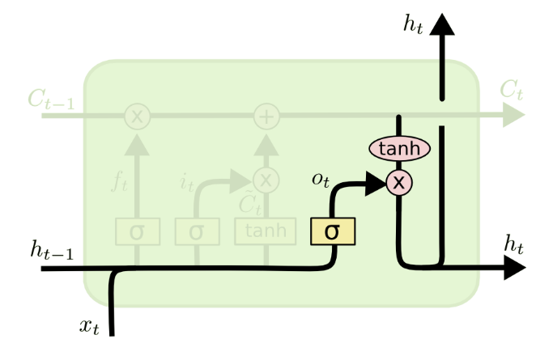
Long Short Term Memory (LSTM)
3 Inputs: Hidden State, Memory(Cell) State, x<t>
Information Highway
Forget Gate
Input Gate – Candidate output
Output Gate
2 Outputs: Memory (Long Term Dependencies), New hidden state
Credits - https://tinyurl.com/q6dcybc/
Notes:
3 Inputs: Hidden State, Memory(Cell) State, x<t>
Forget Gate: What to forget from previous hidden and current input
Input Gate: Calculate current cell state from previous hidden and current input
Output Gate: Calculate new hidden state from current input, previous hidden
2 Outputs: New Memory(Cell) State, New hidden state

Slide 26
Lab Time!

Slide 27

Sentiment analysis
A popular application of Natural Language Processing (NLP) that classifies text or speech into a positive or negative feeling.
Credits- https://tinyurl.com/y7wsgp4b
Notes:
What is sentiment analysis – a NLP application that classifies text or speech into some specified sentiment.
Natural language is processed – something on social media or reviews for products or customer feedback.
Connect this text to a positive or negative sentiment.
Areas where this is used – what are people saying about your brand on Twitter, Facebook.
In 2016 elections, there were a lot of projects on analyzing sentiments from tweets.
Feedback from customers on call centers.
And there can be many more use cases.

Slide 28
Dataset
http://ai.stanford.edu/~amaas/data/sentiment/aclImdb_v1.tar.gz
~12,500 positive movie reviews
~12,500 negative movie reviews
~17,500 samples for training
~7,500 samples for testing
Positive reviews | Negative reviews
"this was an awesome movie!" | ”i just could not watch it till the end."
Notes:
We’re using the data set on movie reviews from rotten tomatoes. This was used in one of the papers at Stanford.
So there were close to 12000 sentences labeled as positive or negative. Approximately half were positive and half were negative.
Out of these 9000 were picked for training, 2000 for testing.

Slide 29
Gluon NLP Toolkit
https://gluon-nlp.mxnet.io/
Extension on top of Gluon
State of the Art (SOTA) deep learning models
Scripts
Model Zoo
High-Level APIs and Abstractions tailored for NLP
Vocabulary, Embedding
Data Loading, Data Pre-Processing, Data Iterators
Operators, Loss Functions

Slide 30
Thank You!
Notes:
Thank you for listening, I hope you learned about deep learning systems and serving, and had a good time.
MXNet and Model Server are open source - feel free to try it out and file issues. We’re also hiring aggressively, so if you have talented friends that want to be part of the DL revolution - feel free to refer and talk to us!
Thank you!

Slide 31
Appendix

Slide 32
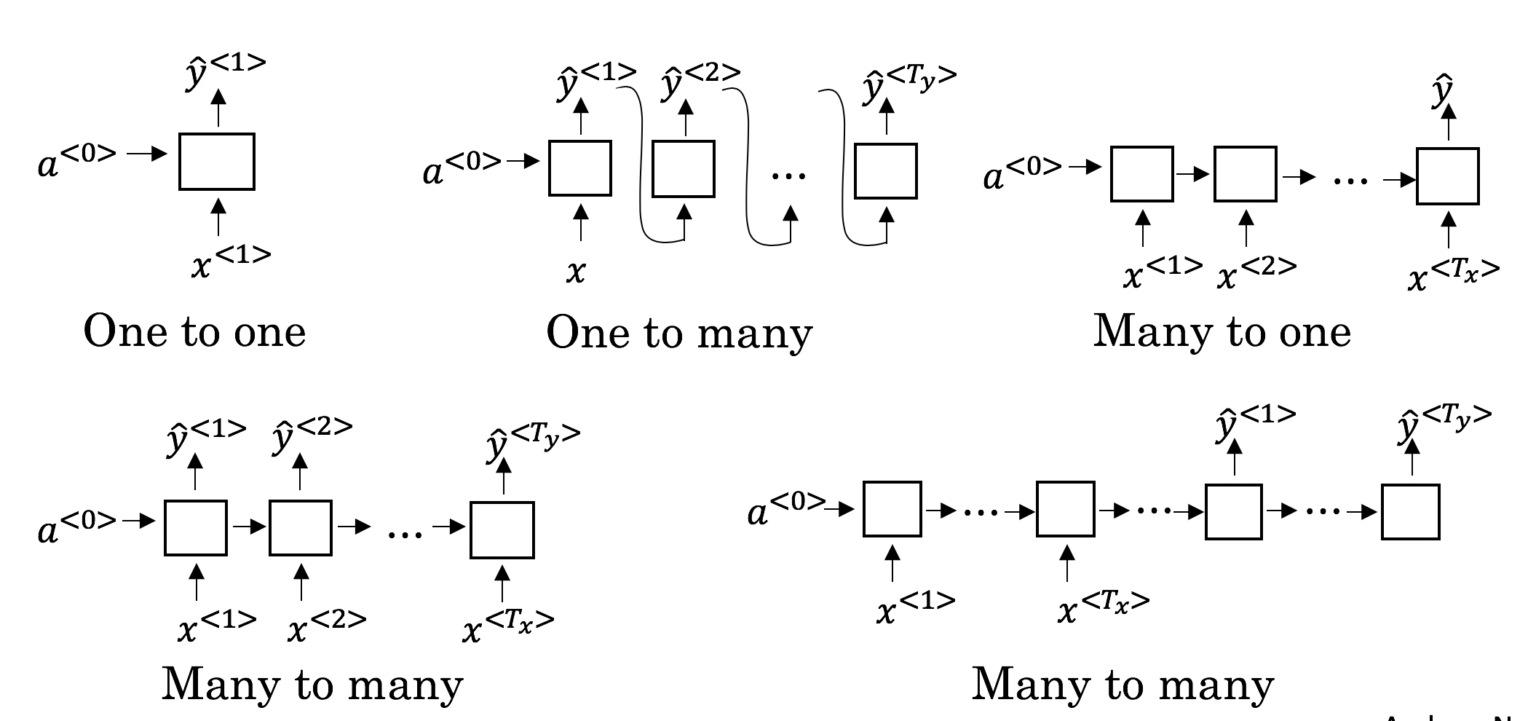
RNN Types
Examples
Word Analogy
Music Generation
Sentiment Classification
Named Entity Recognition
Language Translation
Notes:
Provide Examples.
Credits - https://www.coursera.org/learn/nlp-sequence-models/lecture/BO8PS/different-types-of-rnns
Delete

Slide 33
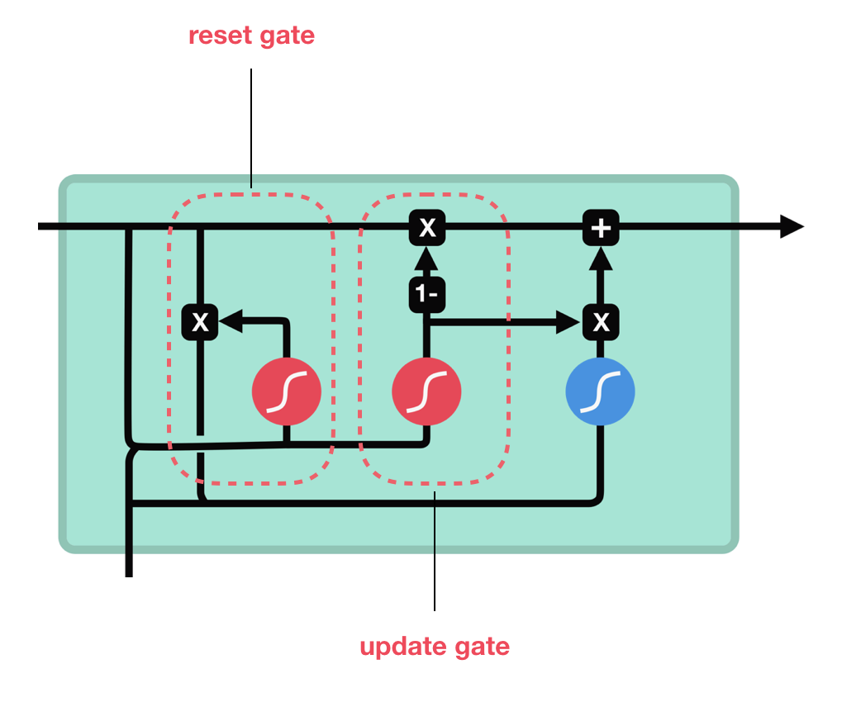
Gated Recurrent Unit (GRU)
Reset Gate: Control how much information to forget from past state h<t>
Update Gate: What info to throw away and new info to add
Output: Combination of past info + current input controlled by Gates
Long-range dependencies flow through time steps
Notes:
Not necessary

Slide 34
Bi-Directional RNN/LSTM
He said, “Teddy bears are on sale!”
He said, “Teddy Roosevelt was a great President!”
Named Entity Recognition
Teddy Roosevelt -> Yes
Teddy bears -> No
Teddy - ? (Unknown)
Problem: RNN, LSTM, GRU - Output of current cell dependent on only sequences from previous time step.
Notes:
Remove

Slide 35
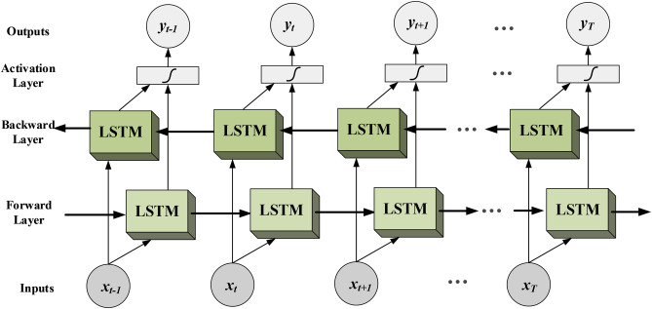
Bi-Directional RNN/LSTM (Contd…)
Cell can be RNN or LSTM
Bi-LSTM – Widely used
Capture info from sequences
after current time steps
2 Layers: Forward, Backward
Forward: Pre-time step info
Backward: Post-time steps info
Forward Pass = Forward Layer
+ Backward Layer
Notes:
More friendly,
Less text

